Slide 1
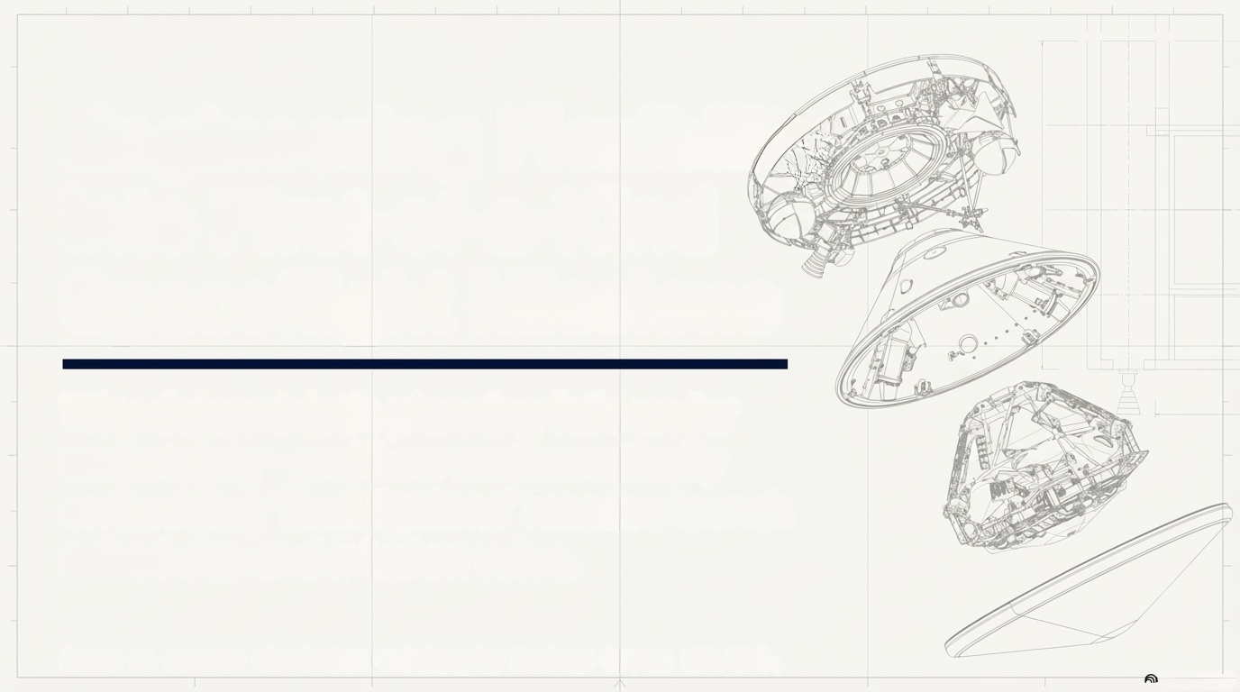
Engineering Flexibility
in First-of-a-Kind
Spaceflight Missions
Using Dynamic Reserves &
Flexible Personnel Allocation
Zachary Barnes | Massachusetts Institute of Technology | EM.424

Slide 2
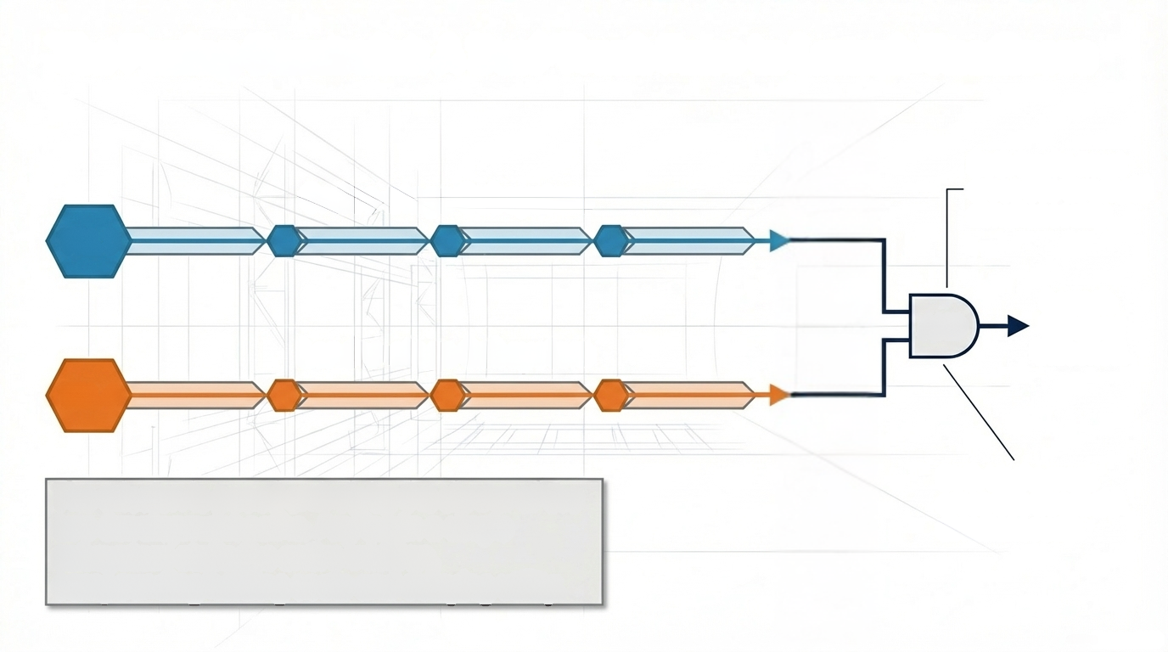

Scenario: A Dual-Subsystem Spacecraft Development Lifecycle
Both tracks must
cross this threshold
simultaneously.
Cruise-stage Subsystem
TRL 3
Launch
Window
Unlocked.
AND
Lander-stage Subsystem
through test and demonstration
TRL 8: Actual system completed and "flight
TRL 4
The system will remain at TRL 8 until the 2-year journey to Mars is complete.
The mission is paced entirely by the slower of the
two development paths. Any lag in a single subsystem stalls the entire mission, compounding holding costs and delaying utility.

Slide 3
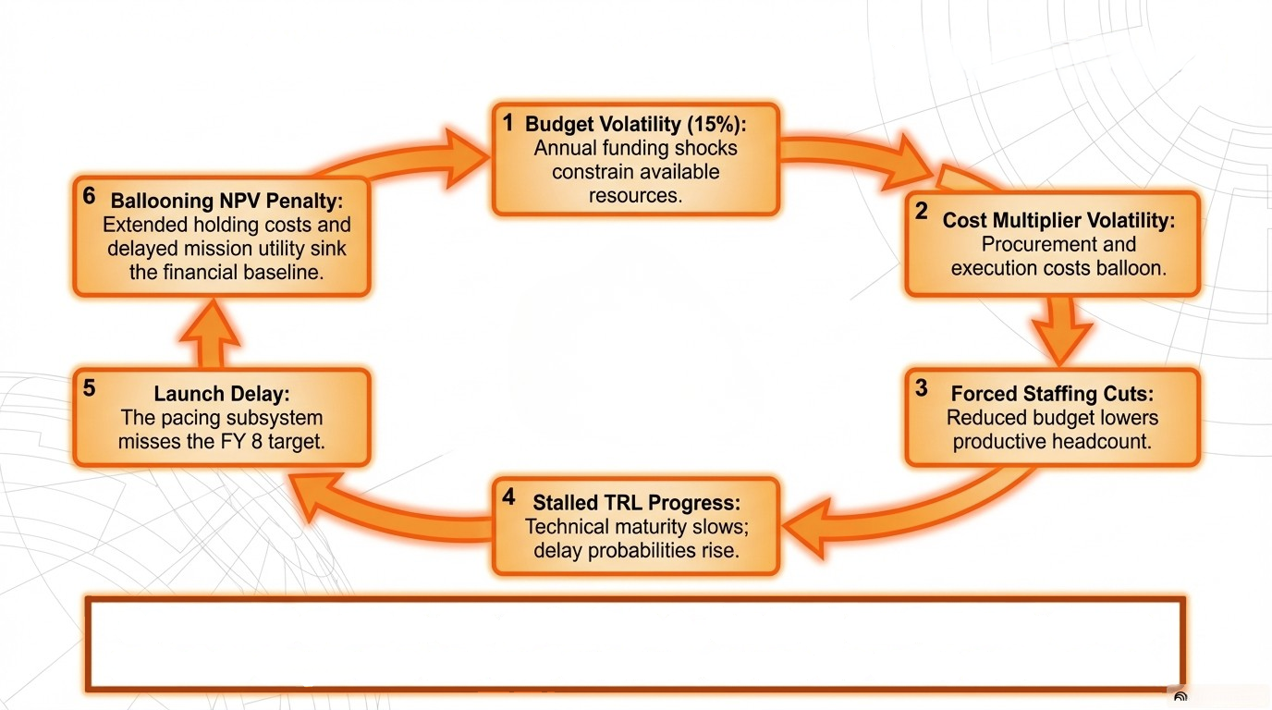
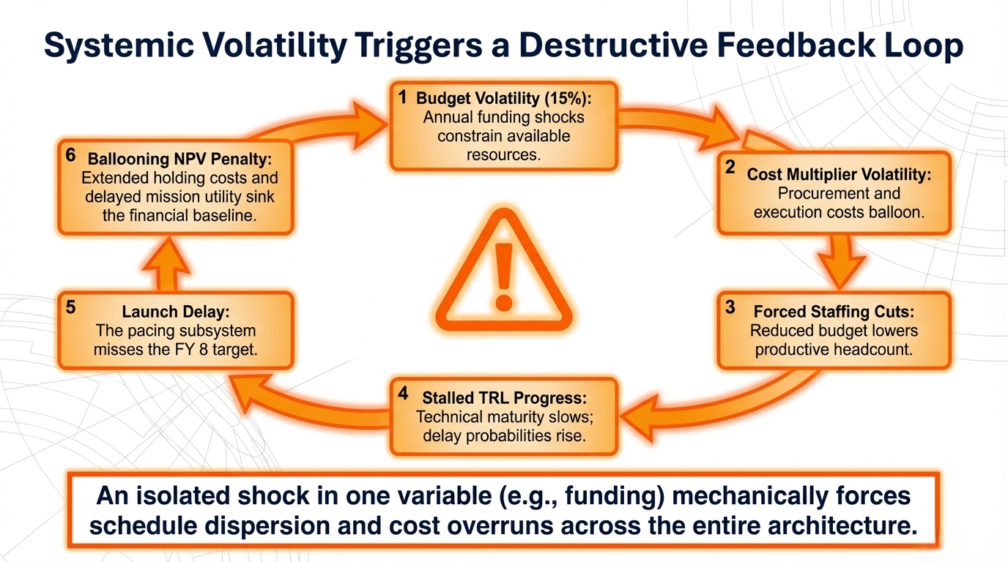
Why Flexibility? (Problem Framing)
An isolated shock in one variable (e.g., funding) mechanically forces schedule dispersion and cost overruns across the entire architecture.

Slide 4
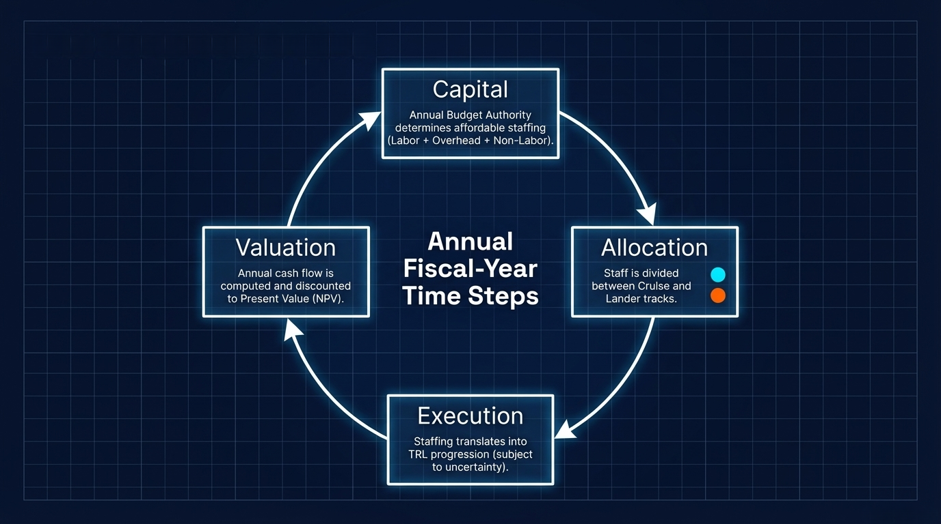

Model Architecture
Mars Exploration Rover (MER)
Spacecraft Cruise & Lander Stage Subsystem Illustration [1]

Slide 5
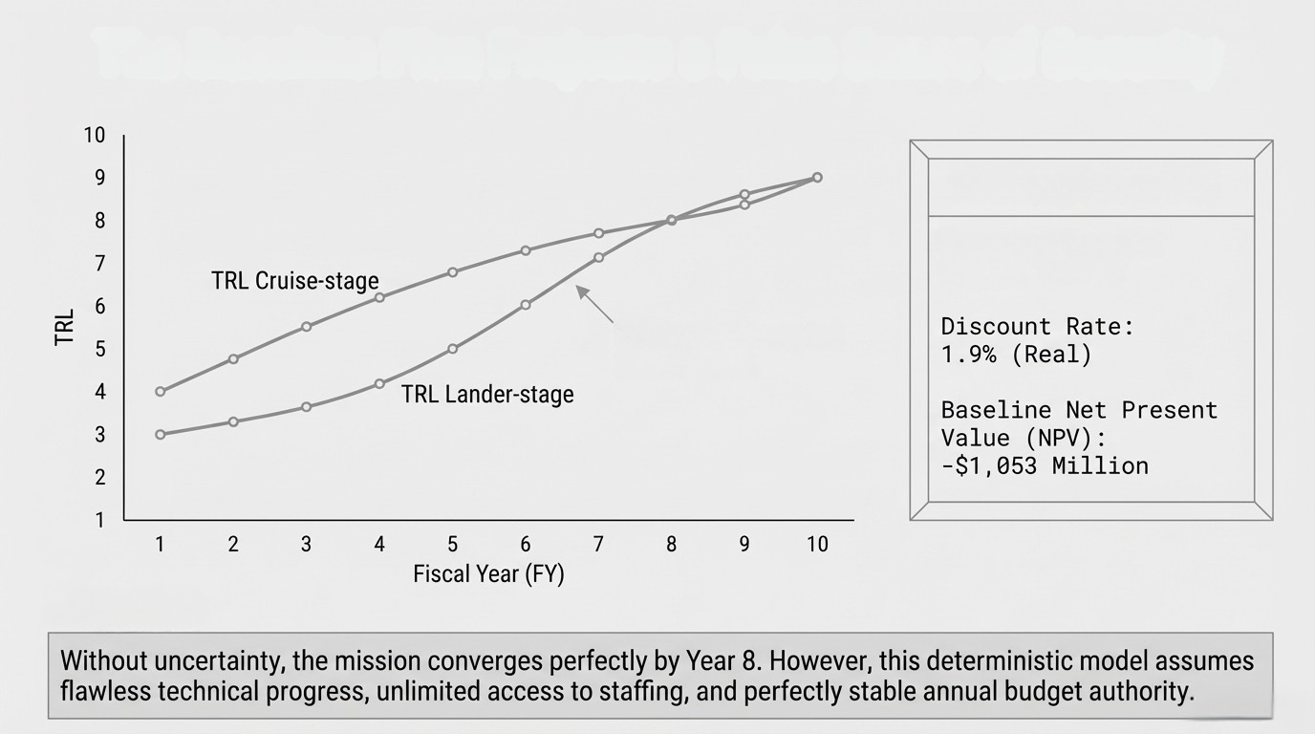
The Baseline Plan (Deterministic Approach)
Key Metrics
Expected Launch:
Fiscal Year 8
Nominal, uninterrupted
path to TRL 8
[2]

Slide 6
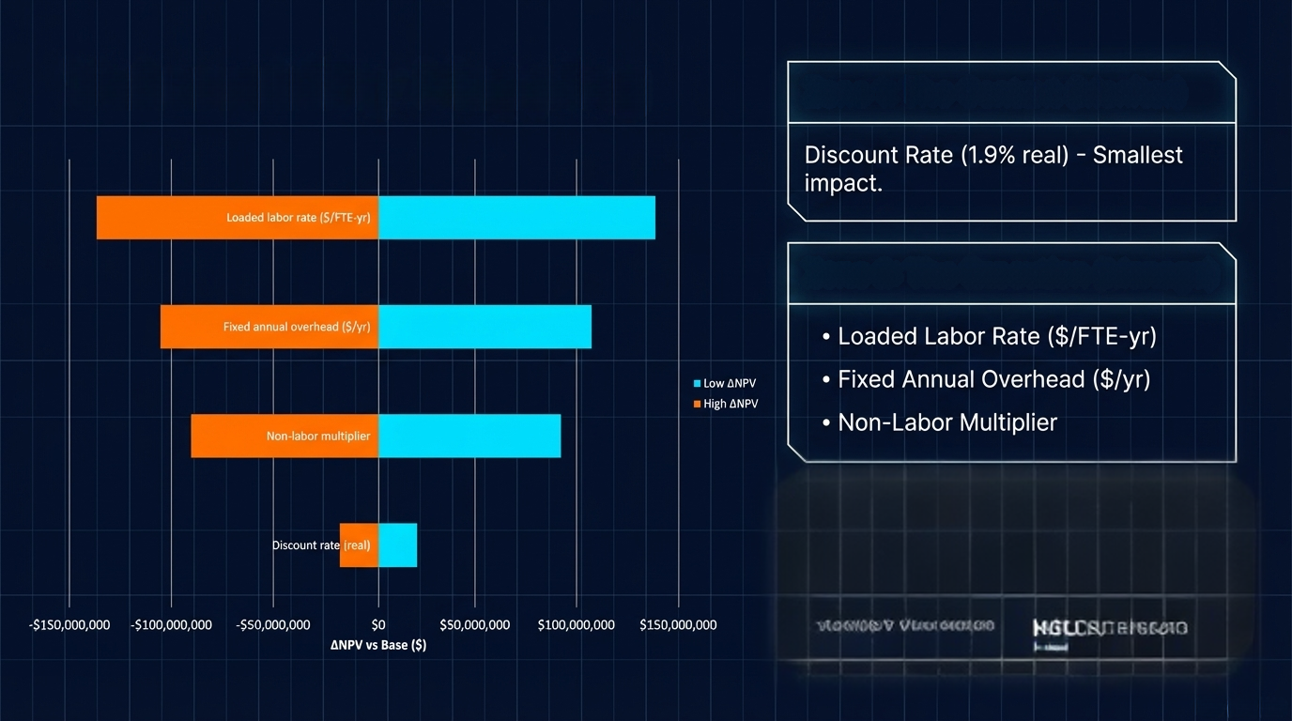
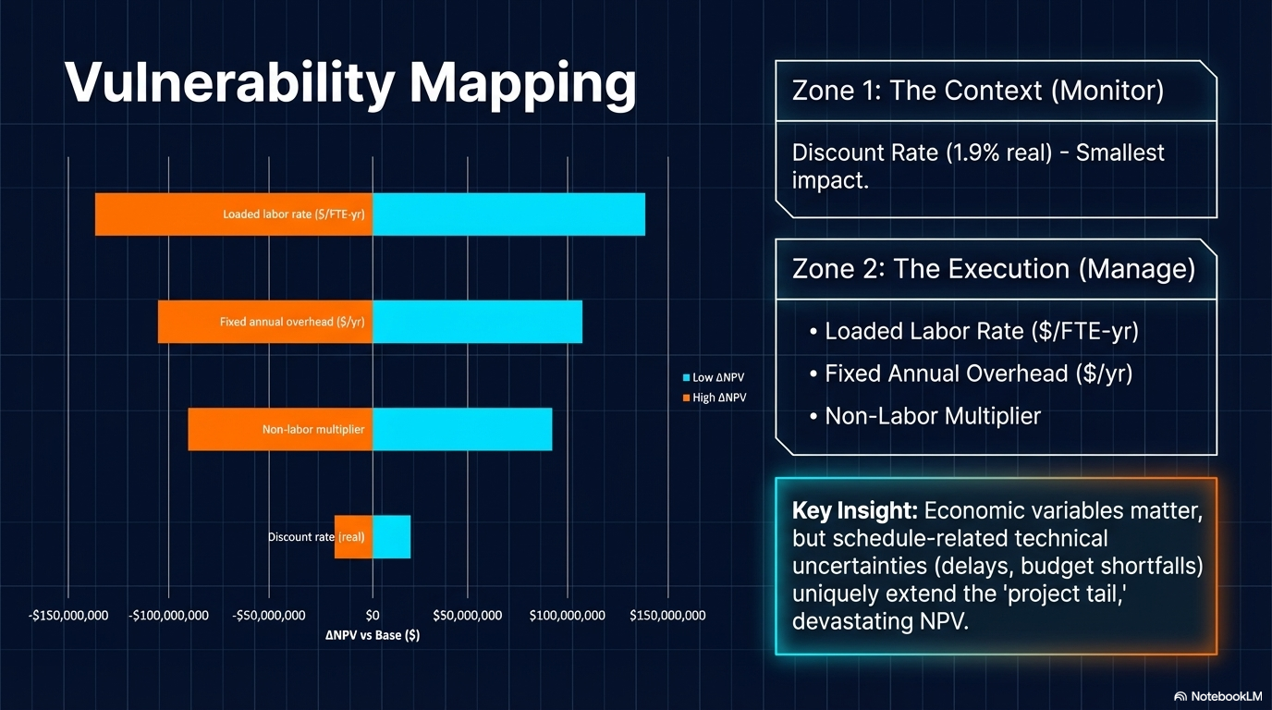
Sensitivity Analysis
Variables to Monitor:
Variables to Manage:
∆
∆
Key Insight: Economic variables matter,
but schedule-related technical
uncertainties (delays, budget shortfalls)
uniquely extend the 'project tail,'
heavily impacting NPV.

Slide 7
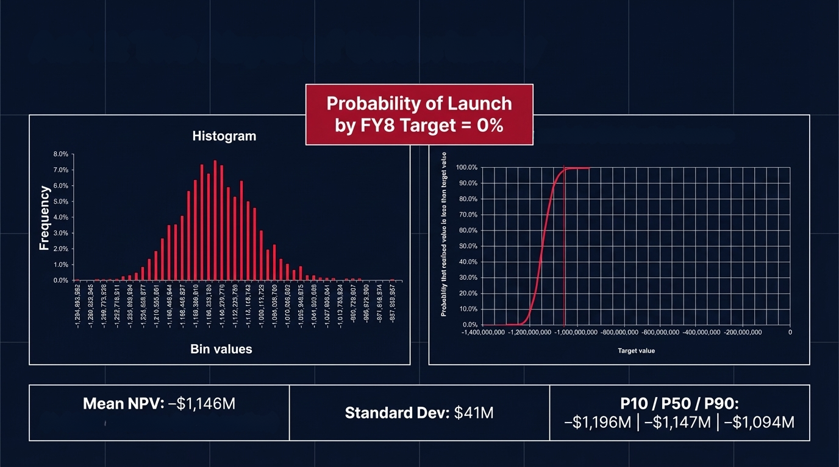
Accounting for Uncertainty
[2]
Cumulative Distribution Function
(A ~$93M overrun from baseline)

Slide 8
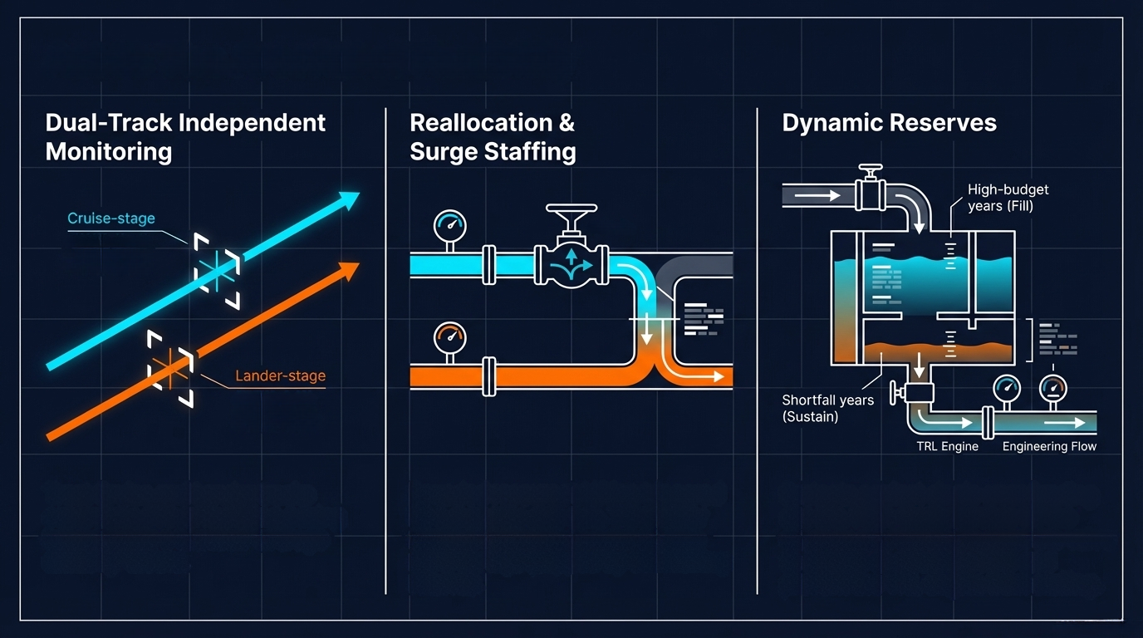

System Flexibility Descriptions
TRL: 7
Staff Count: 120
Allocation Ratio: 0.60
TRL: 5
Staff Count: 80
Allocation Ratio: 0.4
Track Cruise and Lander tracks
separately. Prevents hiding pacing
issues inside a blended 'average
maturity' metric.
Shifting cross-trained staff & resources to the lagging subsystem.
Temporarily increasing staffing threshold when a subsystem severely lags.
Protects against single-year funding
shocks. Unspent authority from high-budget years fills the reserve, which can be used to sustain engineering flow and prevent the TRL engine from stalling in shortfall years

Slide 9
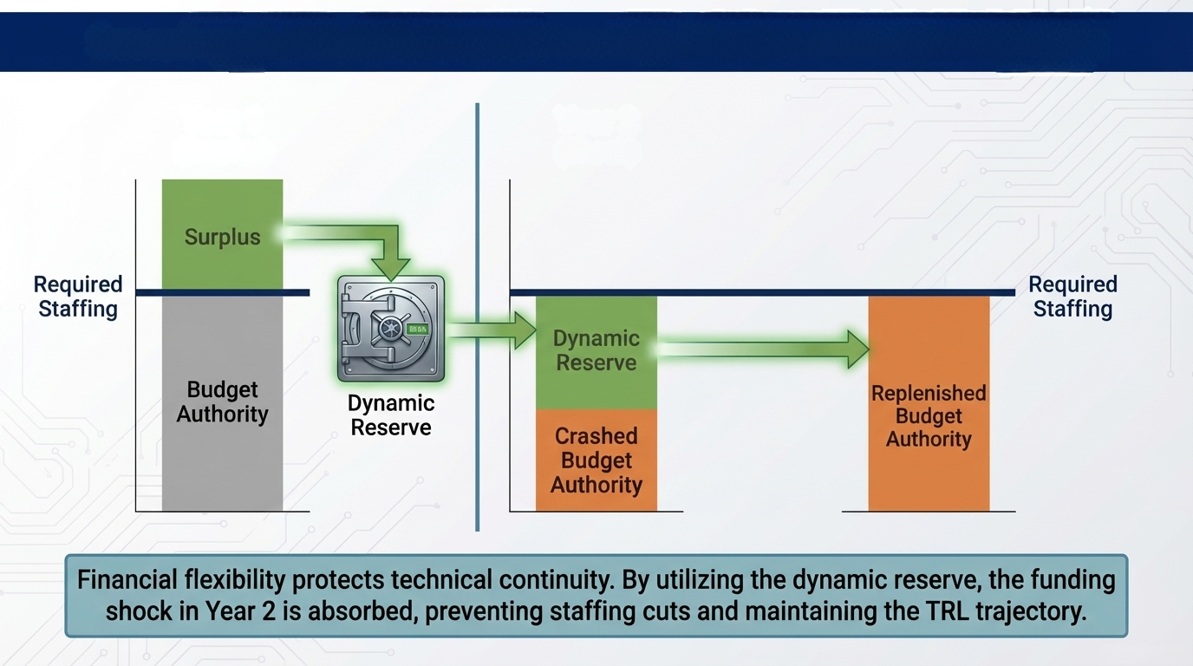
Dynamic Reserves: Real Options Concept Description
Year 1
(Surplus)
Year 2
(Shock + Recovery)

Slide 10
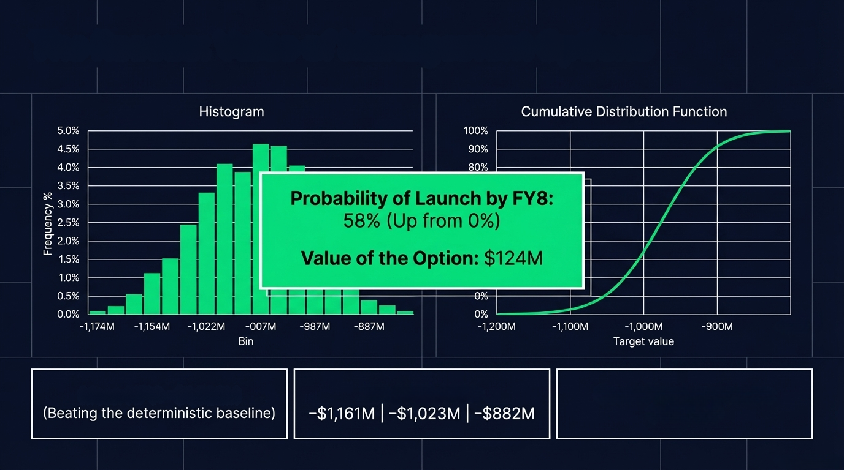
The Value of Management Real Options
[2]
-800M
Mean NPV: -$1,022M
P10 | P50 | P90:
Cost of Implementation:
$625,000

Slide 11
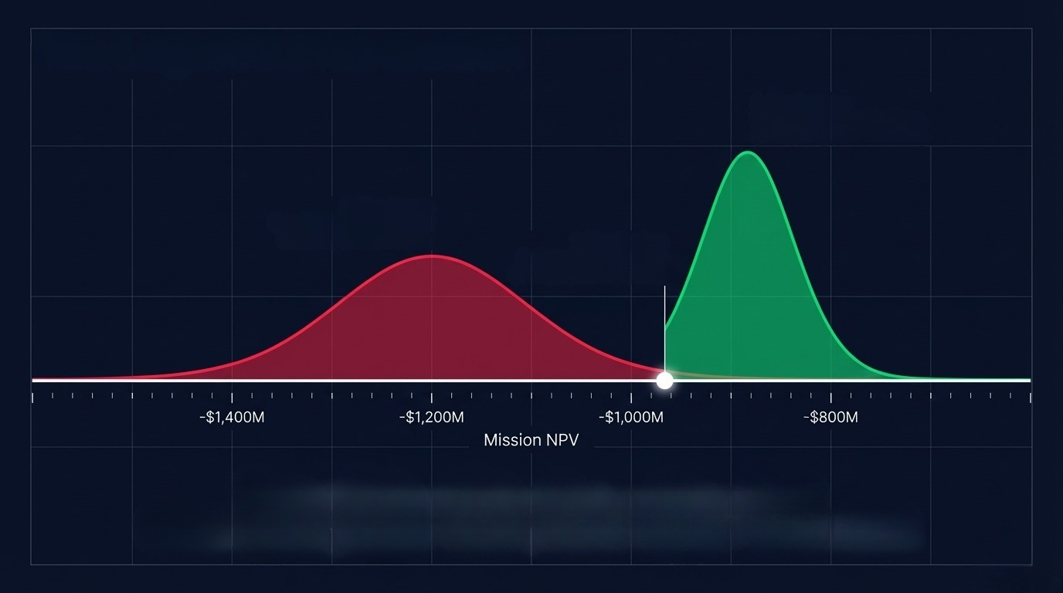

NPV Distribution Comparison
3. Uncertainty with Real Option Implementation:
(Distribution shifted into more positive regime)
  2. Unmitigated Uncertainty: (Massive downside tail)
  1. Deterministic Baseline:
(A single point in space)
Flexibility reduces variance and fundamentally shifts the expected value of the mission.

Slide 12
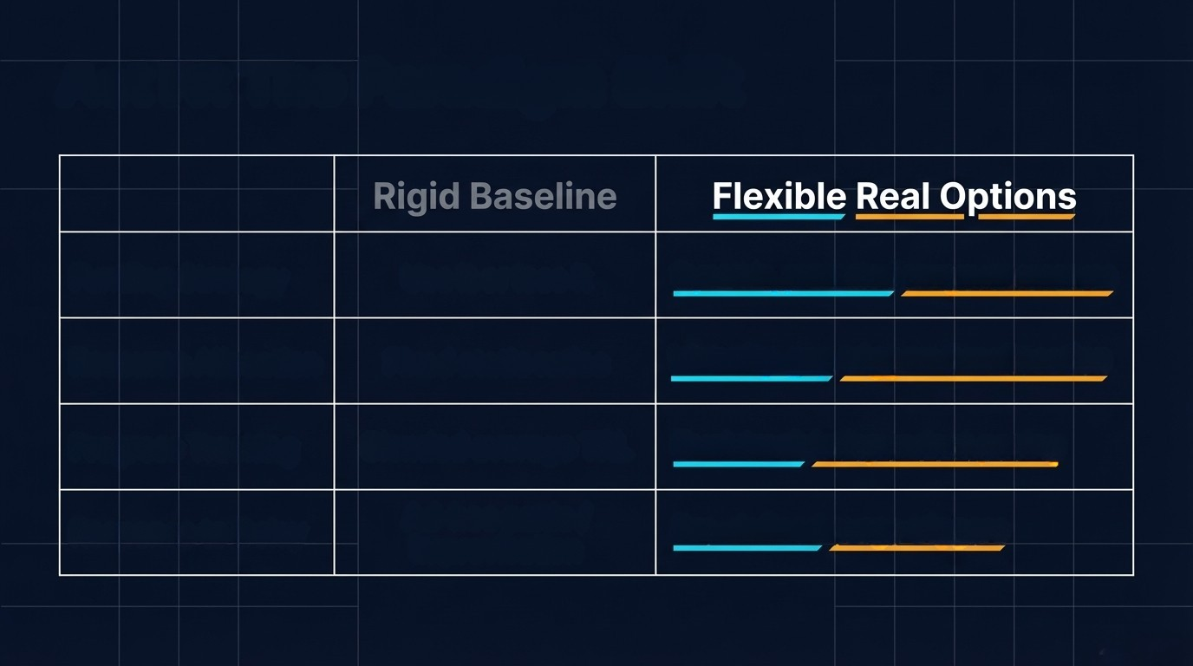
Comparing Management Approaches:
Rigid & Deterministic vs. Dynamic & Flexible
Use it or lose it annual budgets
Funding Strategy
Dynamic, protected carryover reserves
Fixed team sizes and static ratios
Resource Allocation
Cross-training & flexible reallocation
Progress Tracking
Blended average TRL
Dual-track, independent TRLs
Response to Delay
Accepting schedule slip and holding costs
Pre-defined surge triggers

Slide 13

Lessons Learned & Recommendations
Cross-Train Technical Staff
Standardize Shared Assets
Reallocation only works if personnel can move across subsystem boundaries without massive ramp-up losses.
Standardize Mechanical and Electrical Ground Support Equipment (MGSE/EGSE) to allow rapid resource shifting between workstreams.
Institutionalize Surge Rules
Protect the Reserve
Define reallocation and surge triggers before the project starts to prevent underreaction and executive thrash.
Unspent funds in strong years should be mindfully retained to act as a stabilizing shock absorber for future shortfalls.
The goal is not to eliminate uncertainty, but to design a system capable of responding intelligently if and/or when it is revealed [3].

Slide 14
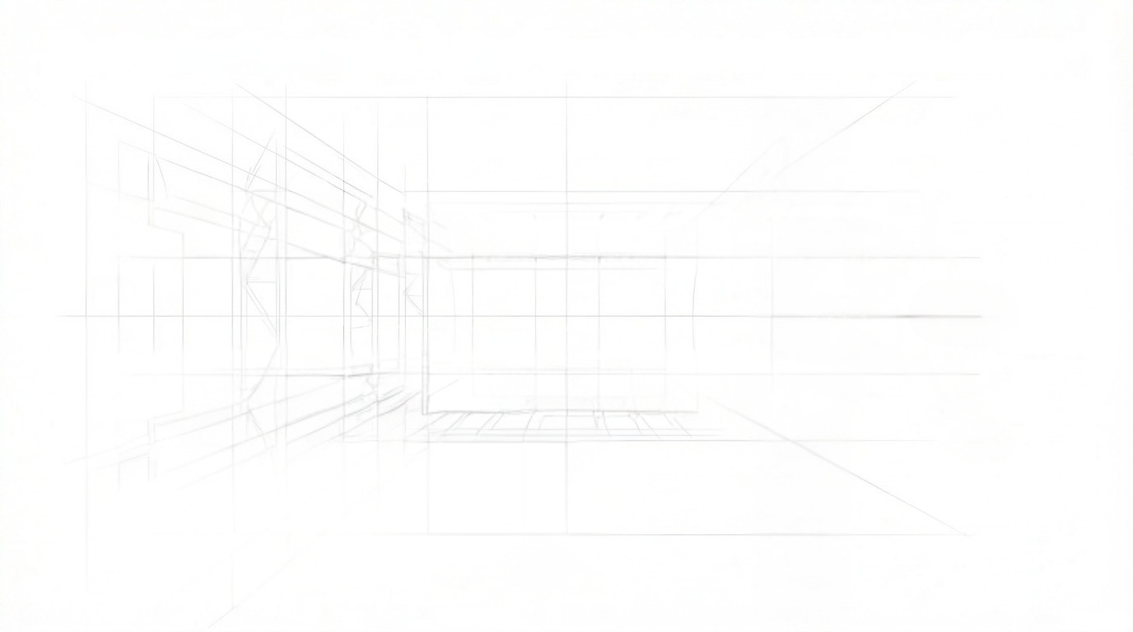
References:
[1] NASA Jet Propulsion Laboratory. Illustration of spacecraft sections, n.d. Image credit: NASA/JPL.
[2] MIT System Design and Management. Garage template 2026 version, 2026. Spreadsheet model template used as the basis for the uncertainty and flexibility analysis.
[3] Richard de Neufville and Stefan Scholtes. Flexibility in Engineering Design. MIT Press, Cambridge, MA, 2011.
[4] Barnes, Zachary. (2026, March 18). Dynamic Reserves, Surge Staffing, and Flexible Personnel Allocation in Complex Spaceflight Missions [Course report]. Massachusetts Institute of Technology, EM.424.

Slide 15
Questions?

Slide 16
Backup Slides

Slide 17
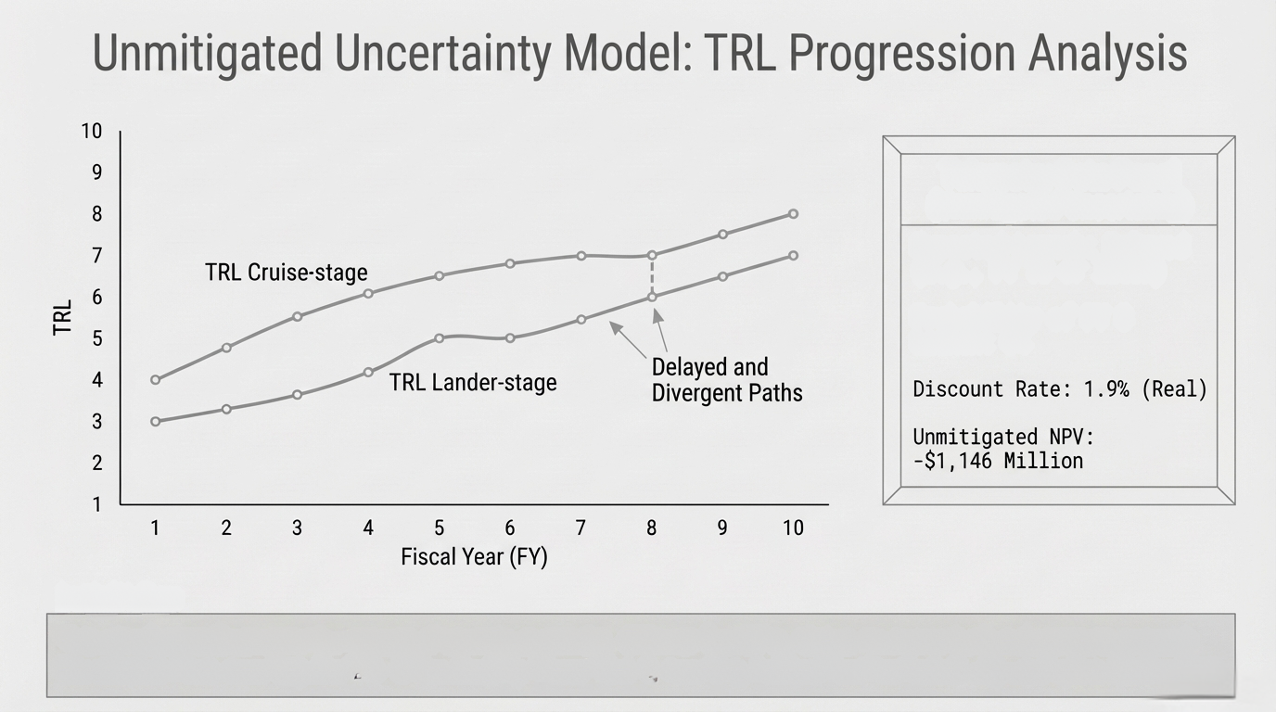
Key Metrics
Expected Launch: Delayed
(e.g., FY 10 or later)
Probability of FY 8 Launch: 0%
[2]
This simulation illustrates the impact of unmitigated risks. Without flexibility, delays in one or both subsystems prevent the mission from reaching the TRL 8 threshold by Fiscal Year 8, resulting in significant schedule slip and cost increase.

Slide 18
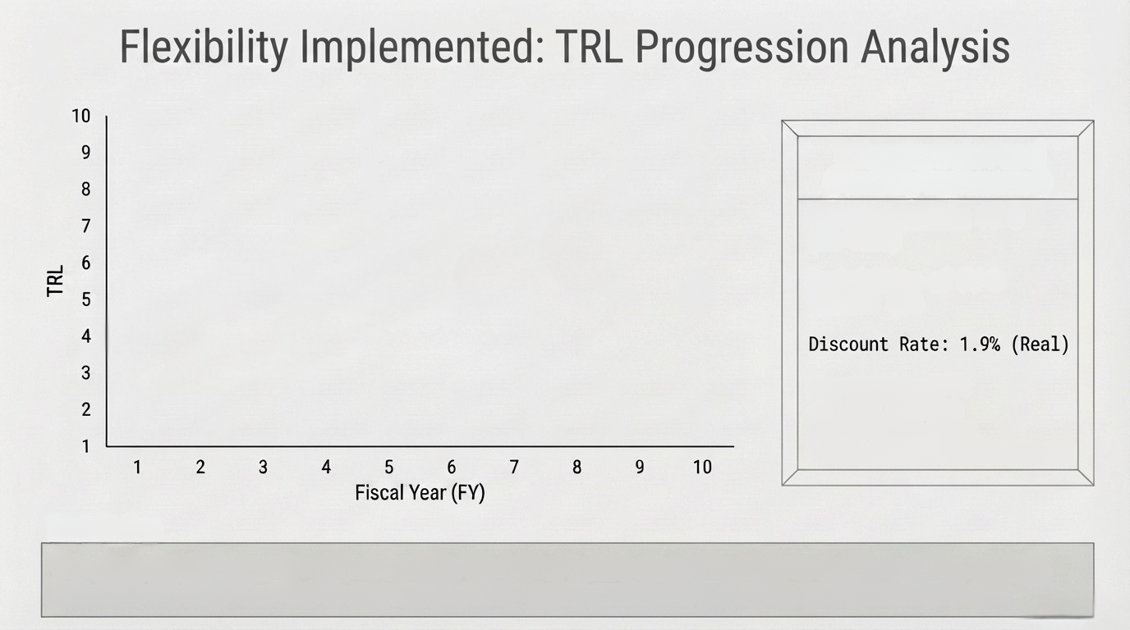
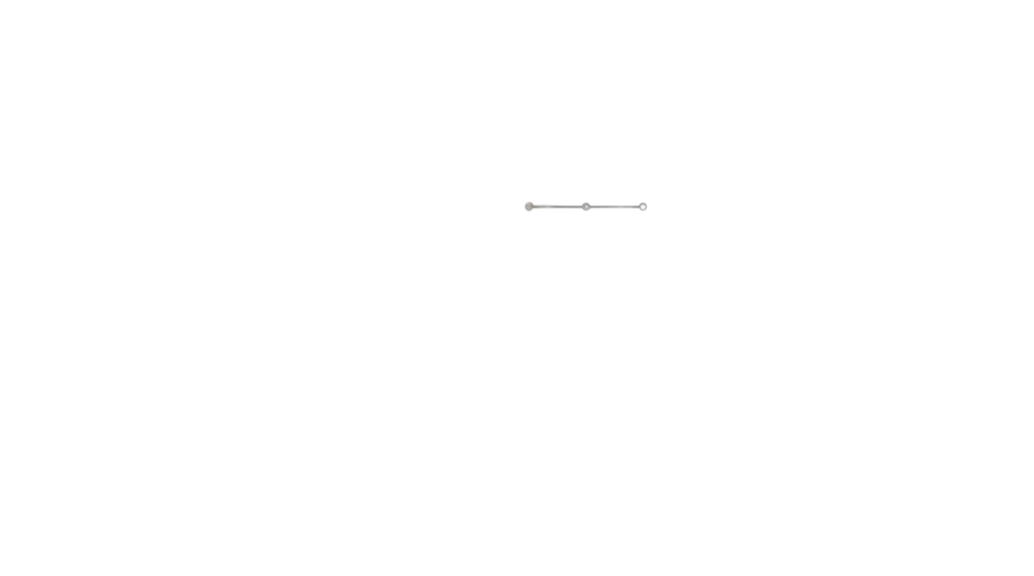
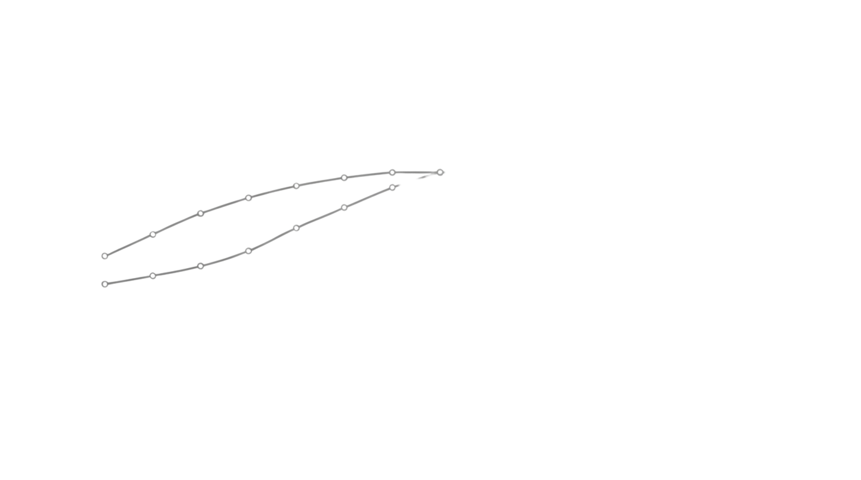

Key Metrics
TRL Cruise-stage
Expected Launch: FY 8
(On-Time)
Flexibility Enables
TRL 8 Convergence
Probability of FY 8 Launch: 58%
TRL Lander-stage
Flexibility NPV:
-$1,022 Million
(+$124 Million above unmitigated uncertainty estimate)
[2]
This simulation illustrates the value of flexibility. Pre-defined options allow subsystems to overcome delays, increasing the likelihood that both reach TRL 8 by FY 8, securing the on-time launch window and generating significant mission value.

Slide 19
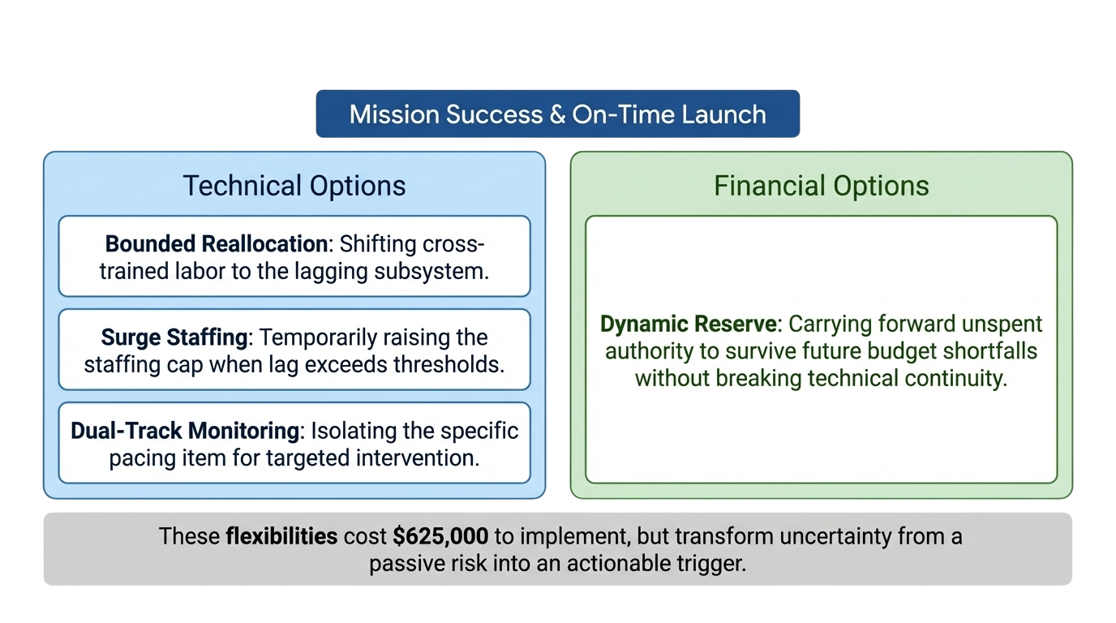
Real Options to Mitigate Uncertainty

